Slide 2
OHC Final Exam Student Login & Exam Navigation

Slide 3
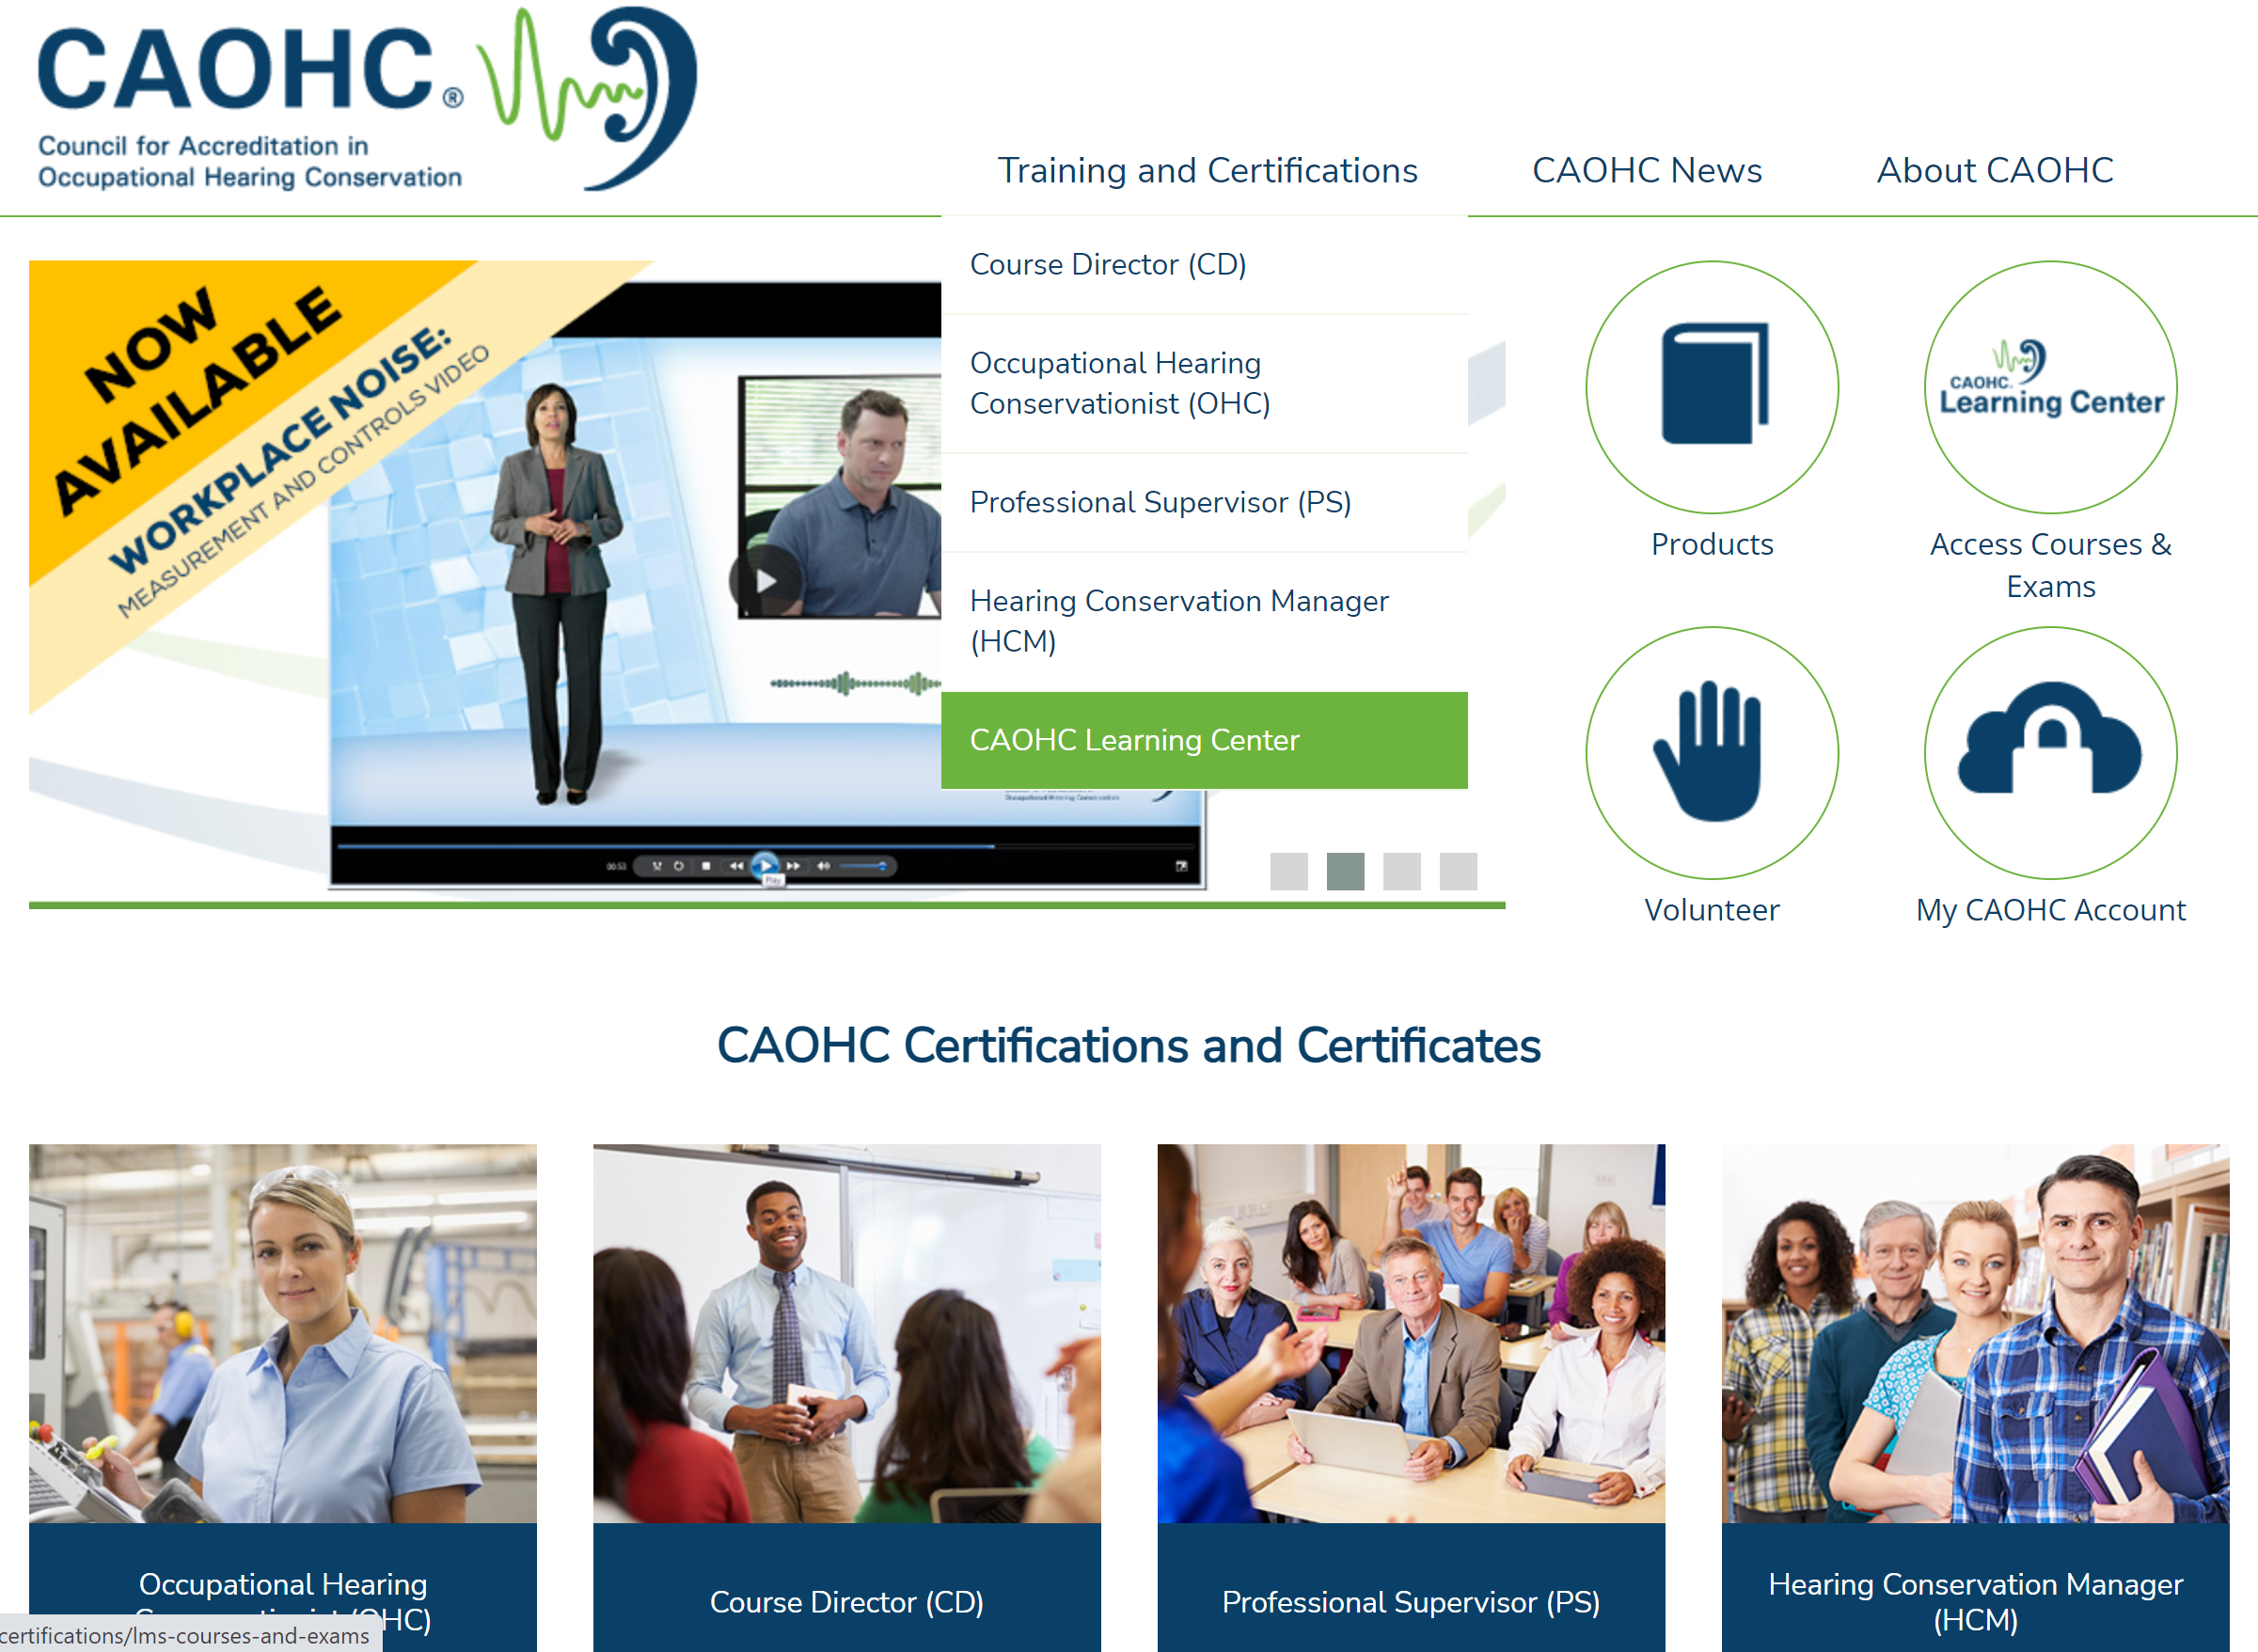
https://www.caohc.org/
Or…
Go to
CAOHC
Learning
Center

Slide 4
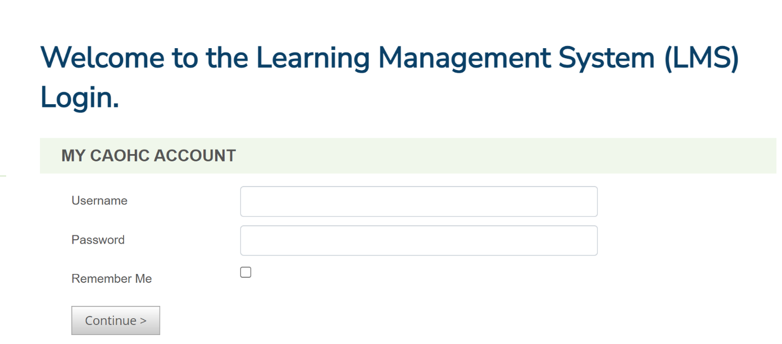
Login to CAOHC Learning Center
Click ‘Continue’

Slide 5
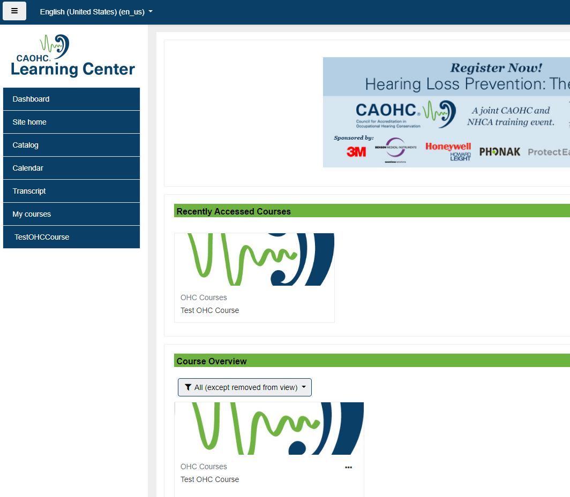
Choose course in ‘Course Overview’

Slide 6
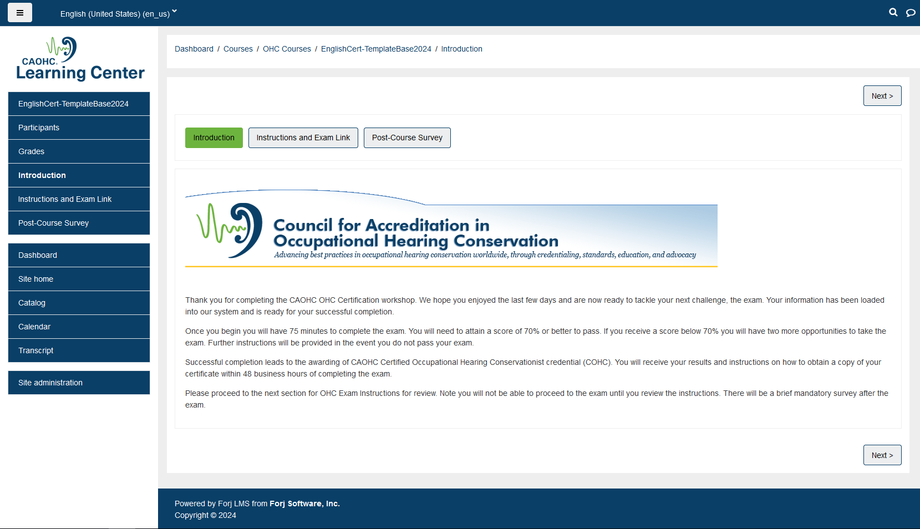
Exam Dashboard

Slide 7
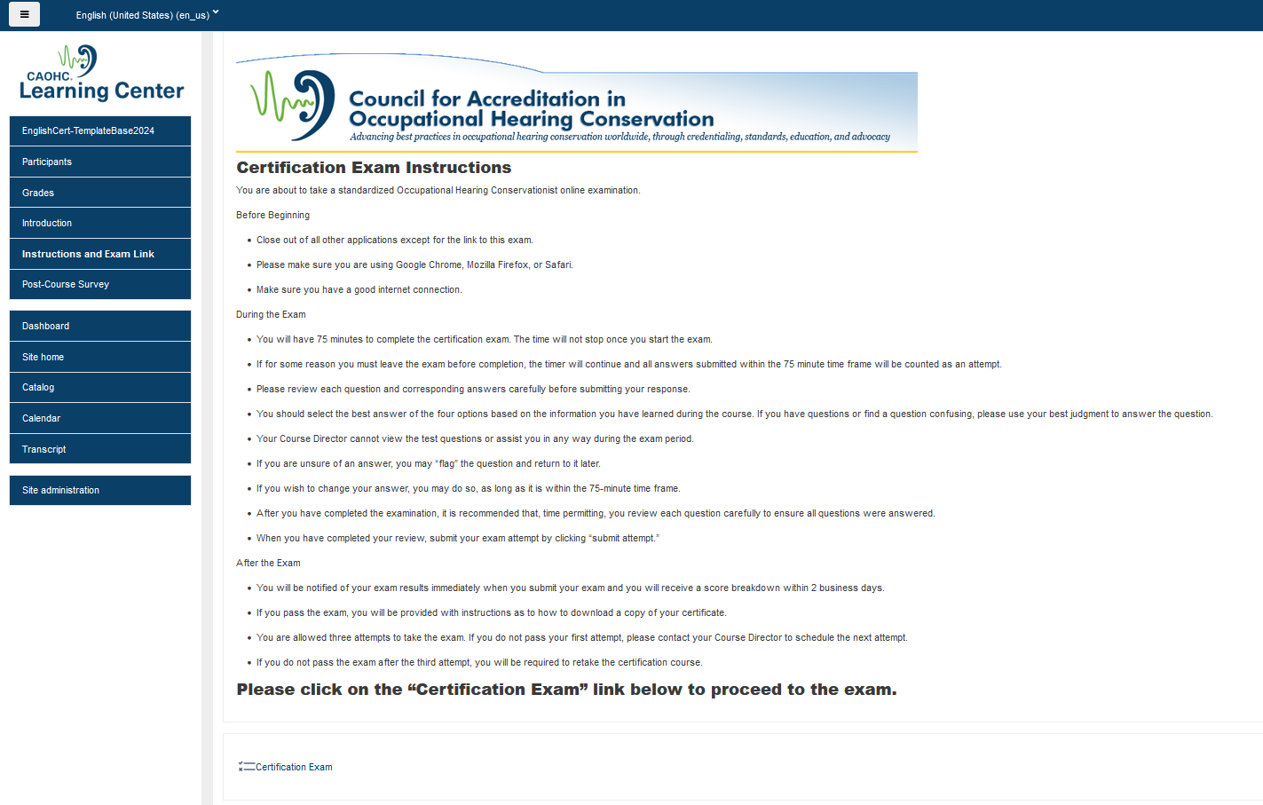
Recerts – 45 minutes

Slide 8
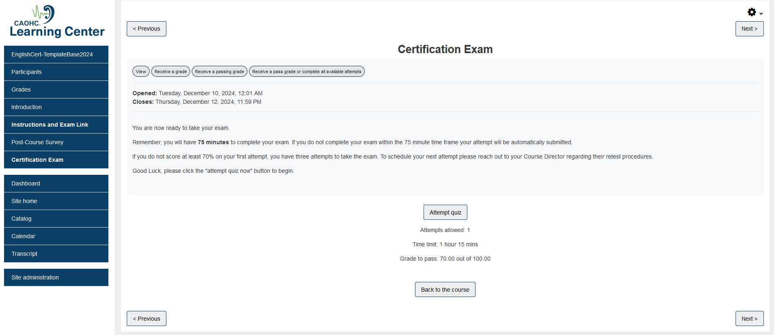

Slide 9
Exam Questions
Time Clock
Flag any question to easily go back for review
Click question #
to review and remove flag

Slide 10
Complete all questions
Identify flagged questions
‘Finish Attempt’ for final review before submission

Slide 11
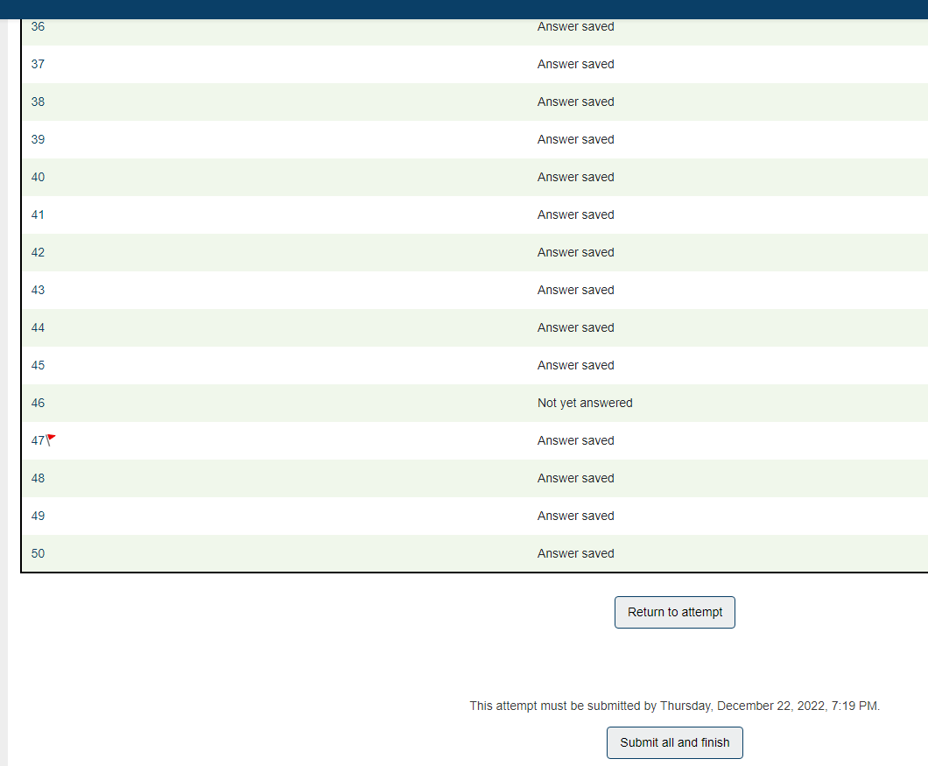
Question Summary & Final Review
Confirm ‘Answer saved’ for all questions
‘Submit all and finish’

Slide 12
Exam Results
Confirm exam grade
70% or better is passing score
Complete ‘Post-Course Survey’

Slide 13
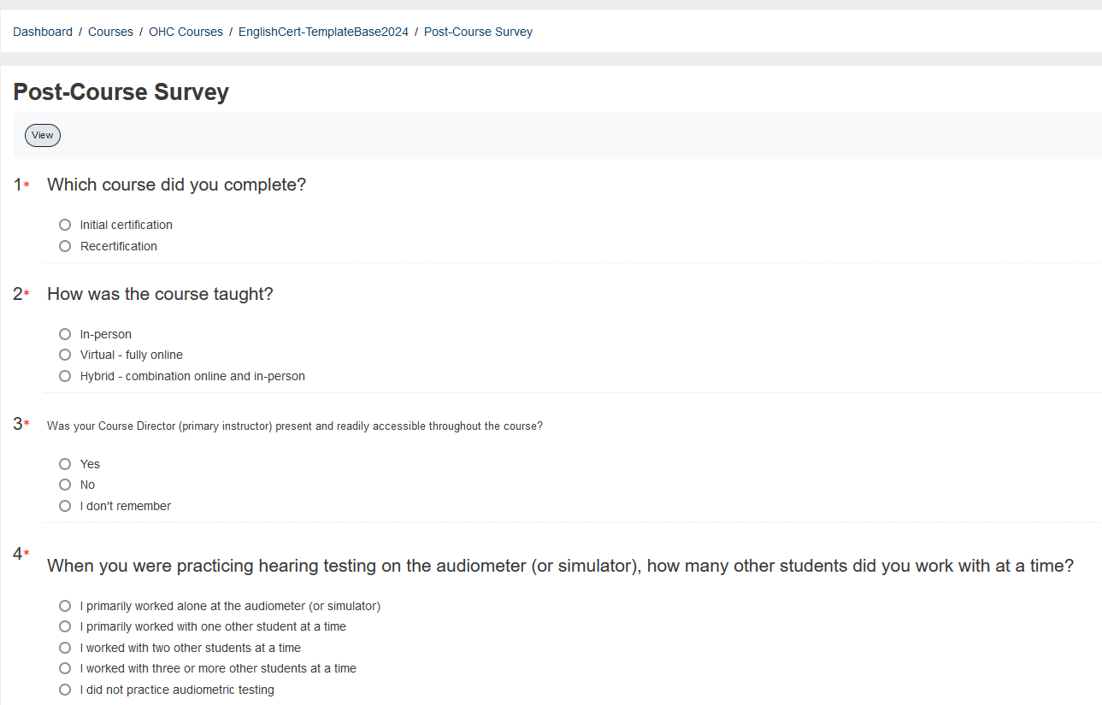

Slide 14
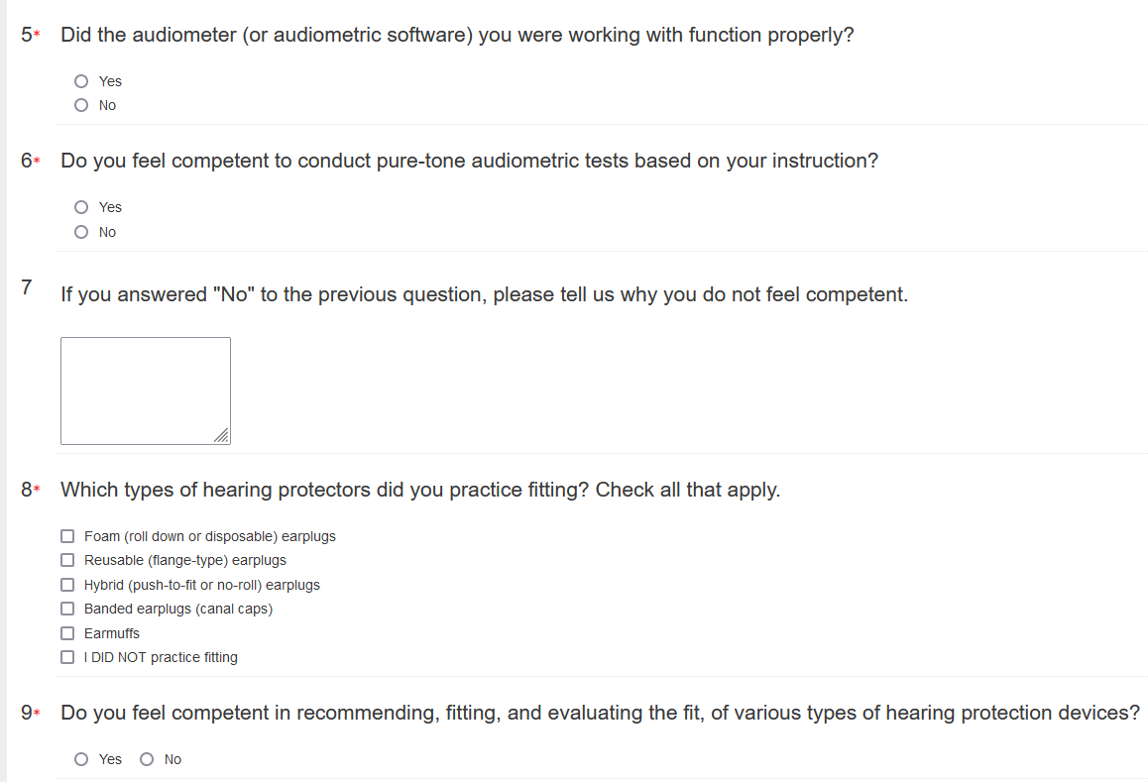

Slide 15
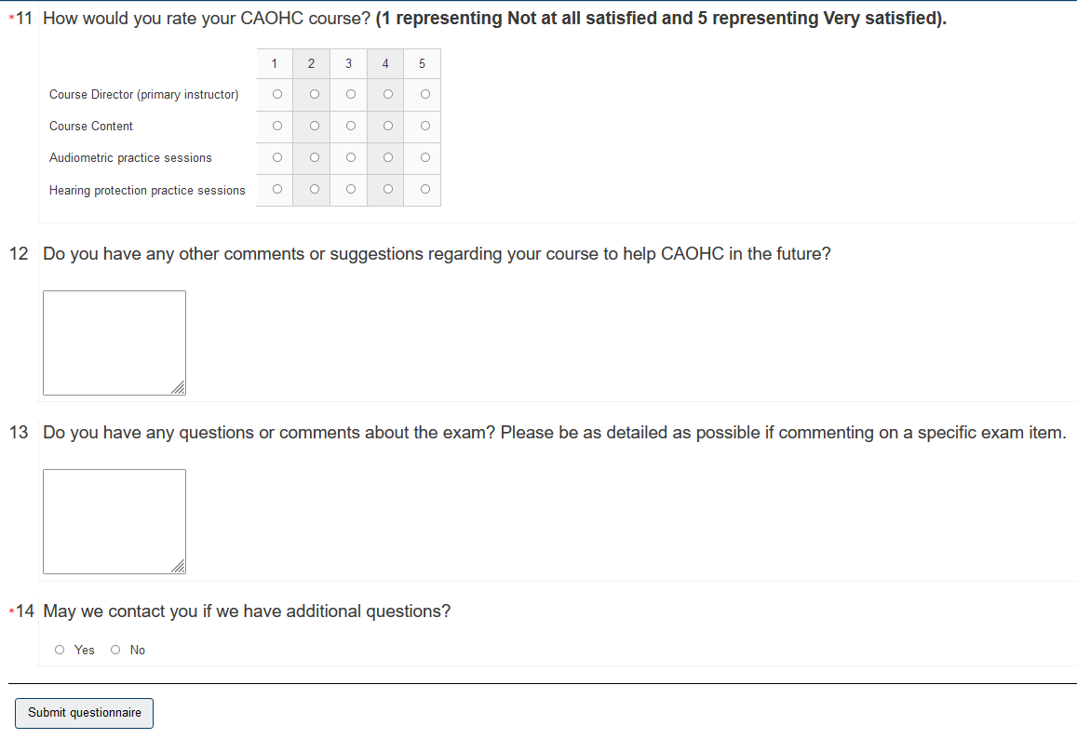
Submit responses and log out

Slide 16
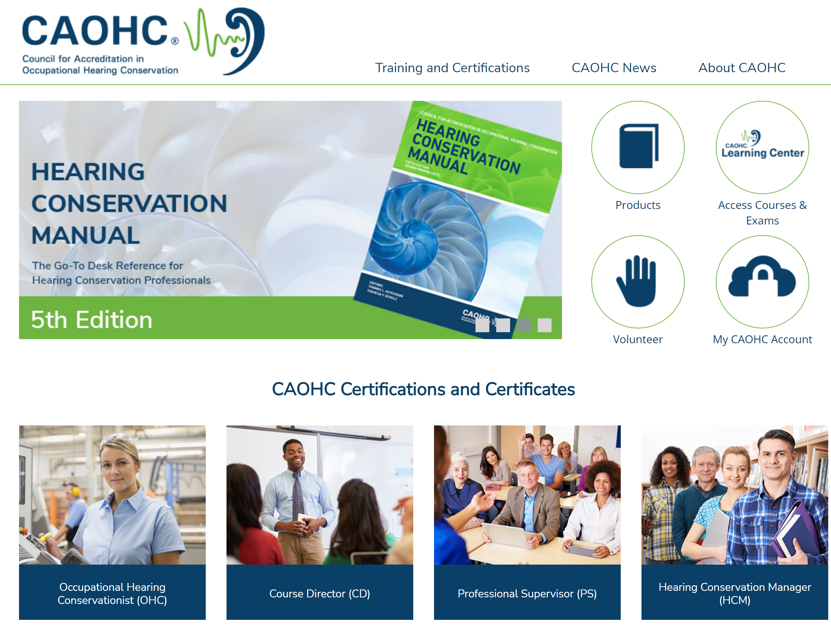
Print / Download OHC Certificate
Available one day after passing exam

Slide 17
Print / Download OHC Certificate

